Slide 1
Generating noisy speech data from clean data in the frequency domain using Deep Learning Methods
Week – 8
Name: Shashank Shirol
University: Manipal Institute of Technology
Duration of the presentation: ~10 mins.

Slide 2
Tasks to be completed:
To modify the official SinGAN implementation:
To try different normalization techniques and find the best one to apply to a spectrogram; tried:
Max Value Normalization
Z-score Normalization
Min-Max Normalization
Try and find the best scaling algorithm that could be applied to a spectrogram, for it to work in a multi-scale architecture such as SinGAN; tried:
Nearest
Bilinear (default)
Bicubic
To try various combinations of Train + paint spectrograms:
Train: Artificial RATs Noise, Paint: Clean RATs Sample
Train: Artificial RATs Noisy Sample, Paint: Clean RATs Sample
Train: RATs Noise, Paint: Clean RATs Sample

Slide 3
Before we begin, how was the SinGAN implementation modified?
Modifications in the helper functions:
Since SinGAN was developed to operate on RGB images (0-255 scale), we had to modify certain methods to work with spectrograms (real numbered matrices) .
SinGAN normalized and denormalized the input image at various stages, we had to change that such that the original spectrogram representation was preserved.
While generating samples, it generated the output in 0-255 scale, so we had to modify that to get appropriate outputs.
Modifications in the Paint2Image module:
The generated outputs were scaled up to match the dimensions of the training audio, modified it to retain the dimensions of the paint file.
Added reconstruction code to reconstruct the audio from the output produced by a trained SinGAN model.

Slide 4
Adding a Normalization technique to SinGAN:
The original implementation of SinGAN used a max-value Normalization to scale the input values in (0-1).
They performed x/255.0 where x is the input RGB image.
NNs perform better when the values are normalized. So, it was necessary to implement a normalization technique without hampering the reproducibility of the signal.
Tried 3 variants of Normalization:
Max-Value Normalization [x/max(abs(x))]
Z-score Normalization [(x – mean(x))/std(x)]
Min-Max Normalization [(x – min(x))/(max(x) – min(x))]

Slide 5
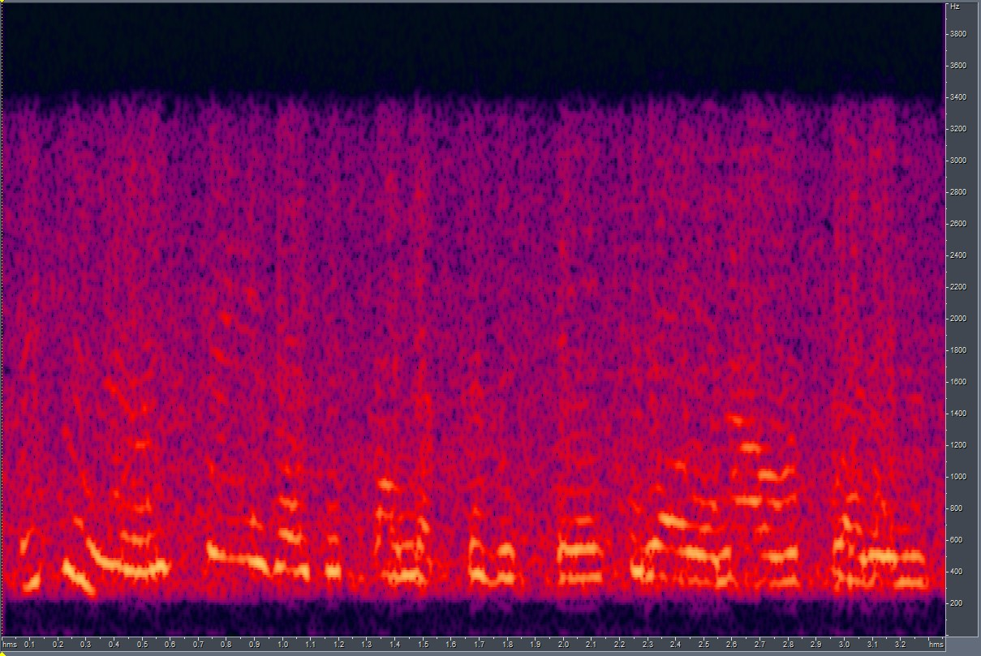

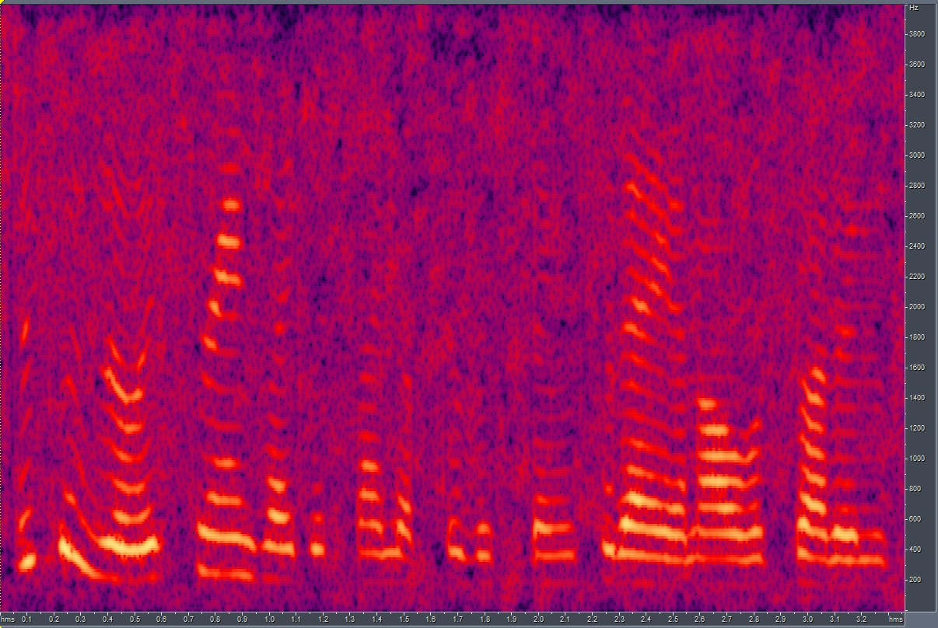
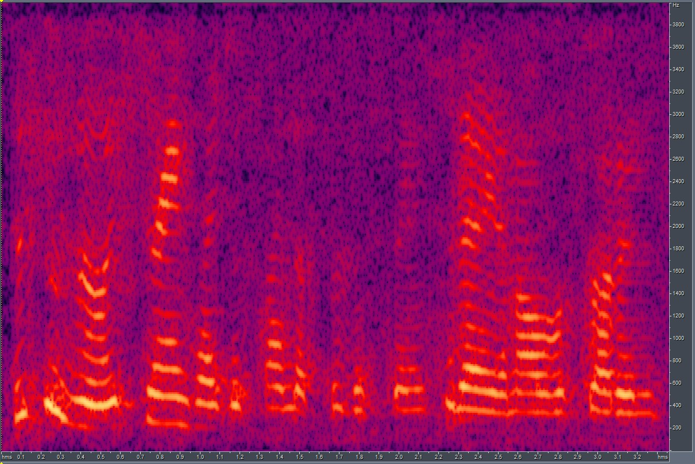
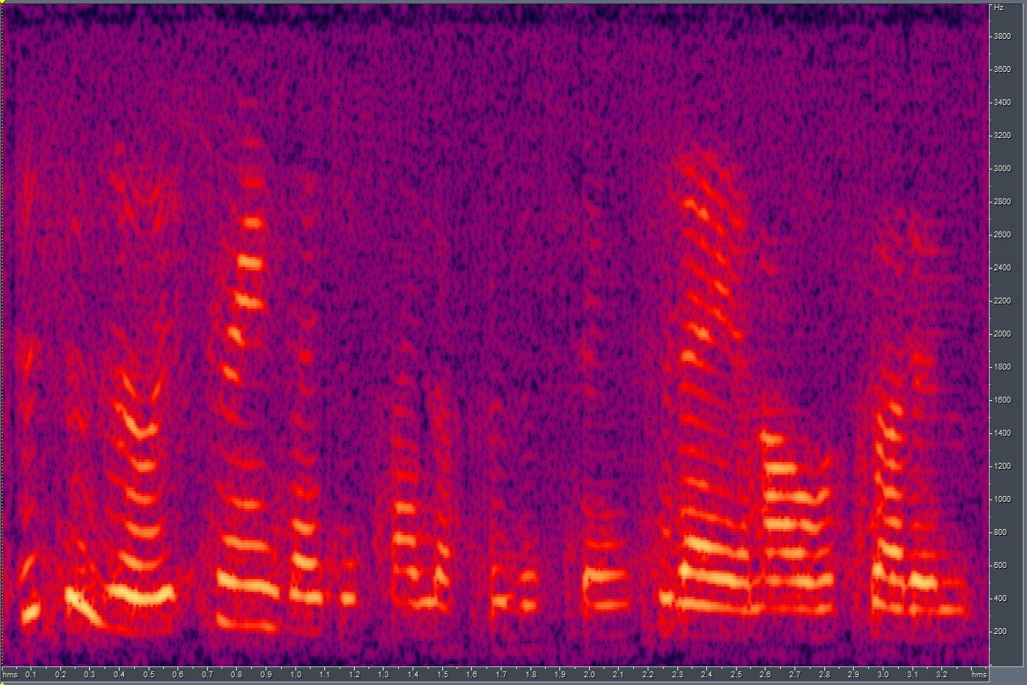
Results of Normalization:
Of the three Normalization techniques, Min-Max Normalization performed comparatively better.
LSDs (Best) with different Normalization techniques:
Z-score Normalization: 12.83; scale=4
Max Value Normalization: 11.9; scale=3
Min-Max Normalization: 11.23; scale=3
Spectrograms:
GT
Z-score
Max Value
Min-Max

Slide 6
Trying different scaling algorithms:
By default, SinGAN uses the “Bilinear” algorithm available in torch.nn.Upsample.
Although it produced acceptable results, we tried other available algorithms that could be applied to 2D matrices, for example, "Nearest”, “Bicubic”.
The performance of the model did not change enough to consider further exploring this parameter.
The LSDs between output and ground truth when different upscaling algorithms were used:
Bilinear: 11.2
Nearest: 11.1
Bicubic: 11.4
Since the results were very close, decided to use the default “bilinear” algorithm.

Slide 7
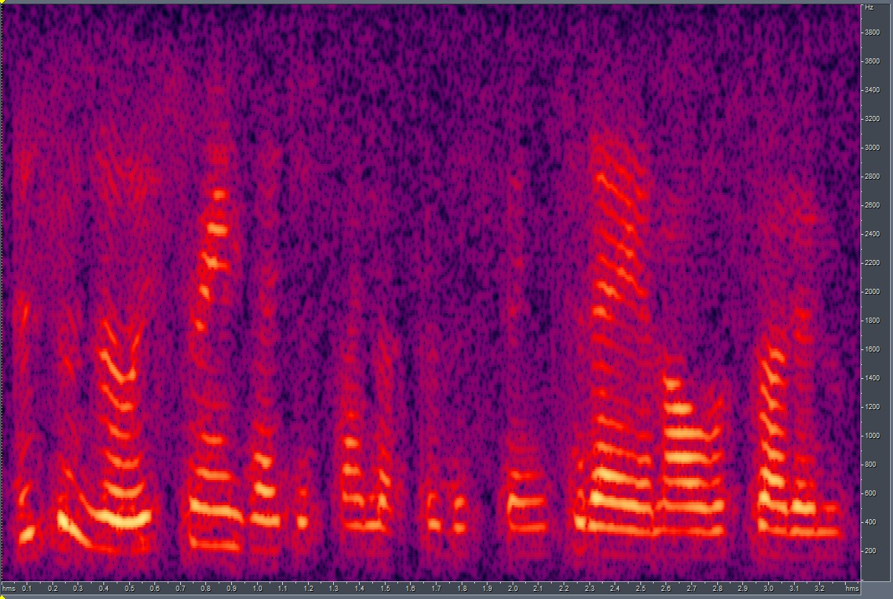
Training SinGAN with different sets of data: (I)
Training: Artificial RATs Noise (8k) Paint: RATs Female Clean (8k)
Training Audio:
LSD score (best) between the outputs and the ground-truth file: LSD = 12.53; scale = 4
Scale = 4
Ground Truth:
Paint Audio:
Scale=4 output
Ground truth

Slide 8
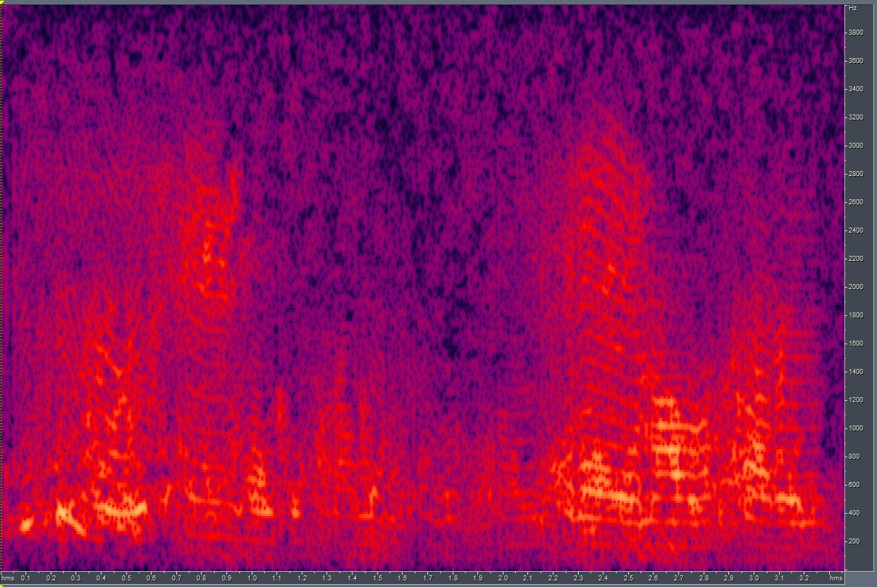
Training SinGAN with different sets of data: (II)
Training: RATs Noise (8k) Paint: RATs Female Clean (8k)
Training Audio:
LSD score (best) between the outputs and the ground-truth file: LSD = 12.14; scale = 2
Scale = 2
Ground Truth:
Paint Audio:
Scale=2 output
Ground truth

Slide 9
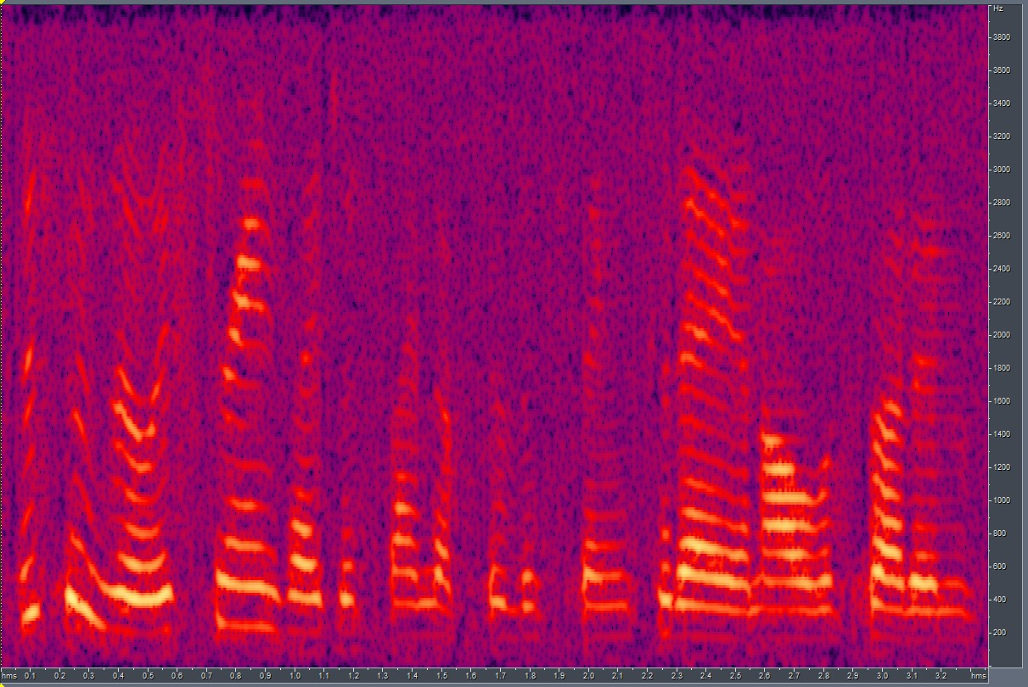
Training SinGAN with different sets of data: (III)
Training: Artificial RATs Noisy sample (8k) Paint: RATs Female Clean (8k)
Training Audio:
LSD score (best) between the outputs and the ground-truth file: LSD = 12.05; scale = 4
Scale = 4
Ground Truth:
Paint Audio:
Scale=4 output
Ground truth

Slide 10
End.

